Slide 1
Fandango Movie Rating Discrepancy Analysis using Python
Presented By:
SRI VASU DEVAN S
GRACE COLLEGE OF ENGINEERING
MECHANICAL DEPARTMENT

Slide 2
OUTLINE
Problem Statement
Proposed System/Solution
System Development Approach
Algorithm & Deployment
Result
Conclusion
Future Scope
References

Slide 3
Problem Statement
The Fandango movie rating system has been under scrutiny for potential discrepancies compared to other rating platforms like IMDb and Rotten Tomatoes. This project aims to analyze the extent of the rating differences and identify potential factors contributing to these disparities.

Slide 4
Proposed Solution
To address the problem statement of analyzing discrepancies in movie ratings between Fandango and other platforms like IMDb and Rotten Tomatoes, we propose the development of a comprehensive analysis system using Python. This system will enable us to collect, clean, and analyze movie ratings data from multiple sources, allowing for a thorough investigation into the accuracy and transparency of Fandango's rating system.

Slide 5
System Approach
Objective Definition: Clearly define project goals and objectives.
Data Collection: Gather movie rating data from Fandango and other sources.
Data Preprocessing: Clean and standardize the collected data.
Exploratory Data Analysis (EDA): Explore data distribution and characteristics.
Statistical Analysis: Compare Fandango's ratings with other sources statistically.
Time Series Analysis: Analyze changes in Fandango's rating display practices over time.
Sentiment Analysis: Evaluate user sentiment towards Fandango's ratings.
Insights and Recommendations: Summarize findings and provide actionable insights.

Slide 6
Algorithm & Deployment
Algorithm:
Utilize statistical methods like hypothesis testing or regression analysis to compare Fandango's ratings with those from other sources.
For sentiment analysis, employ natural language processing (NLP) algorithms such as sentiment analysis using machine learning models like Naive Bayes, Support Vector Machines (SVM), or Recurrent Neural Networks (RNNs).
Consider time series analysis algorithms like ARIMA or LSTM for examining temporal changes in Fandango's rating practices.
Deployment:
Develop the analysis using Python and relevant libraries such as Pandas, NumPy, Scikit-learn, and NLTK .
Host the project on a cloud platform like AWS, Google Cloud Platform, or Microsoft Azure.
Visualize results using libraries like Matplotlib, Seaborn, or Plotly for easy interpretation

Slide 7
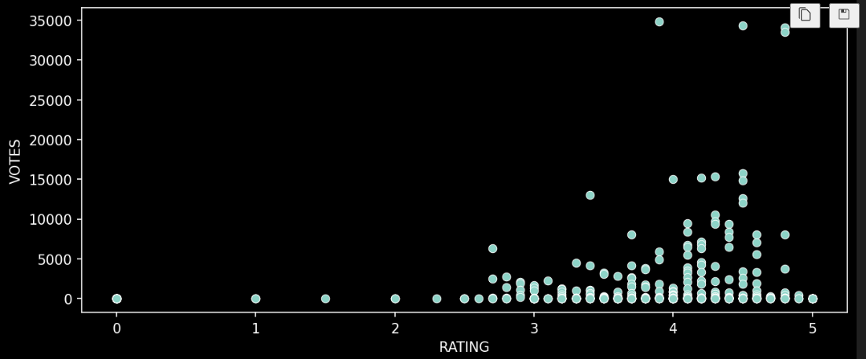
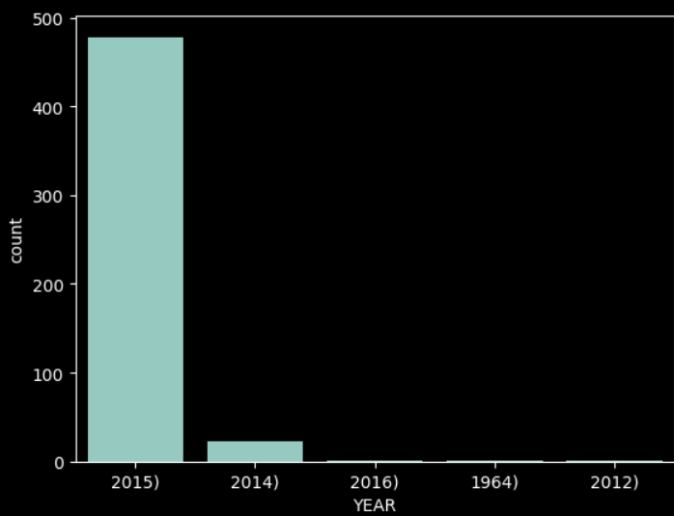
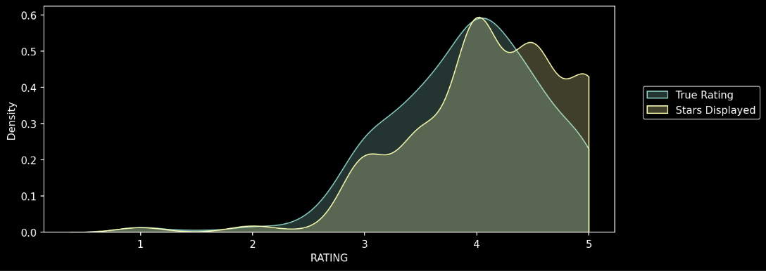
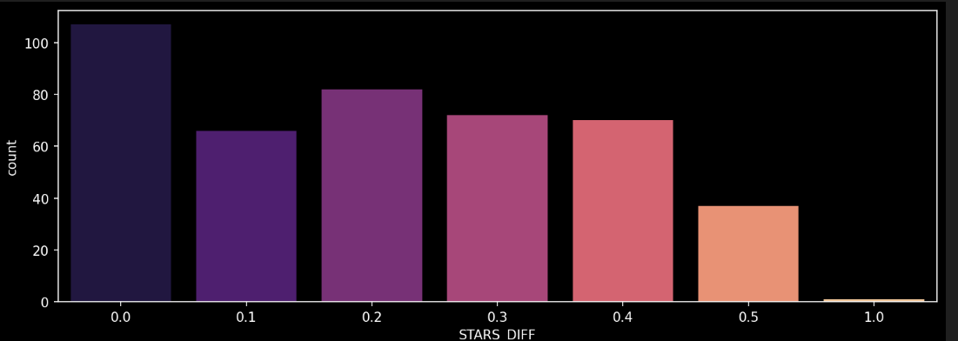
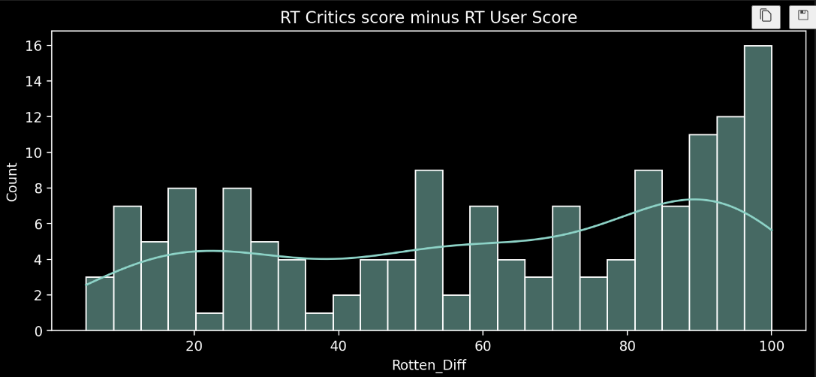
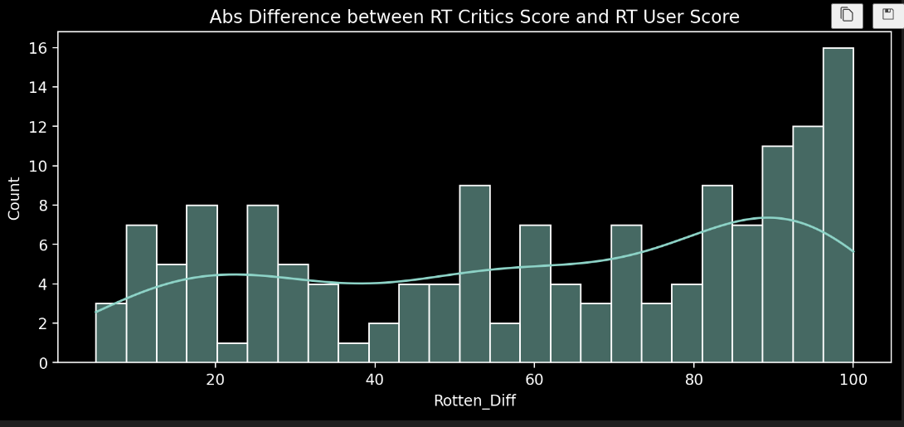
Result

Slide 8
Conclusion
Summarize the main findings of the analysis and discuss the implications for moviegoers and the movie industry.
Reflect on the potential reasons behind the rating discrepancies and their impact on consumer decision-making.
Highlight the importance of transparency and accuracy in movie rating systems.

Slide 9
Future scope
Explore additional factors that may contribute to rating differences, such as genre, release date, and promotional tactics.
Conduct sentiment analysis on user reviews to gain deeper insights into audience perceptions of movie ratings.
Investigate potential improvements to Fandango's rating system to enhance accuracy and credibility.

Slide 10
References
https://www.kaggle.com/
https://github.com/
https://youtu.be/GsfT2sv_zCo?si=7oSQDYeac-0jdexA

Slide 11
THANK YOU

